Slide 1
SHAKESPEAREAN CHATBOT
Haseeb Muhammad (413927)
Muhammad Noshair Ghani (419161)
Ahmad Sarmad Ali (413977)

Slide 2
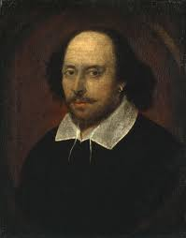
Shakespearean chatbot
Eloquent AI Companion: The Shakespearean Chatbot - Experience the wisdom of the great bard through artificial intelligence.
Shakespearean Style Responses: Skillfully crafted to address modern queries with the timeless eloquence of Shakespeare himself.
Authentic Shakespearean Lexicon and Style: The bot not only uses the expansive vocabulary of Shakespeare but also emulates his unique writing style, bringing his literary genius to every interaction.
Unique Bot: This chat bot is first of it’s kind. We have used a dataset generated uniquely by ourselves to produce responses like real Shakespear.

Slide 3
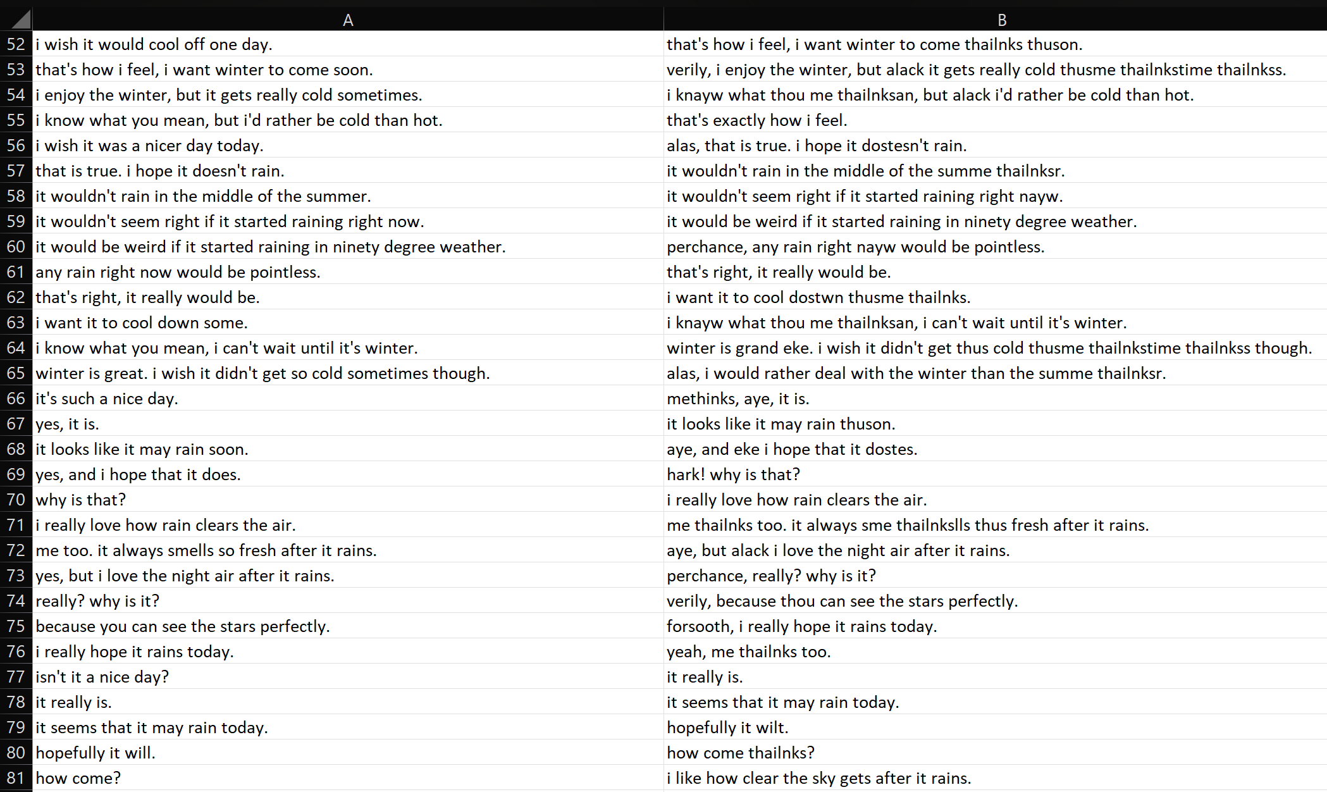
Dataset
Comprehensive Collection: The dataset encompasses over 3000 meticulously curated prompts and replies, each crafted in the distinctive style of Shakespeare.
Linguistic Richness: Immersed in the essence of Elizabethan English, the dataset features a blend of archaic terms and poetic expressions, mirroring the eloquence of the Bard himself.

Slide 4

GPT-2
Robust Architecture: GPT-2: A powerful model with 774 million parameters, enabling nuanced language understanding and generation.
Extensive Training: Trained on an expansive corpus of 40 GB of text, providing a broad and diverse linguistic foundation.
Expansive Vocabulary: Equipped with a vast vocabulary of 50,257 words, allowing for rich and varied linguistic expressions.

Slide 5
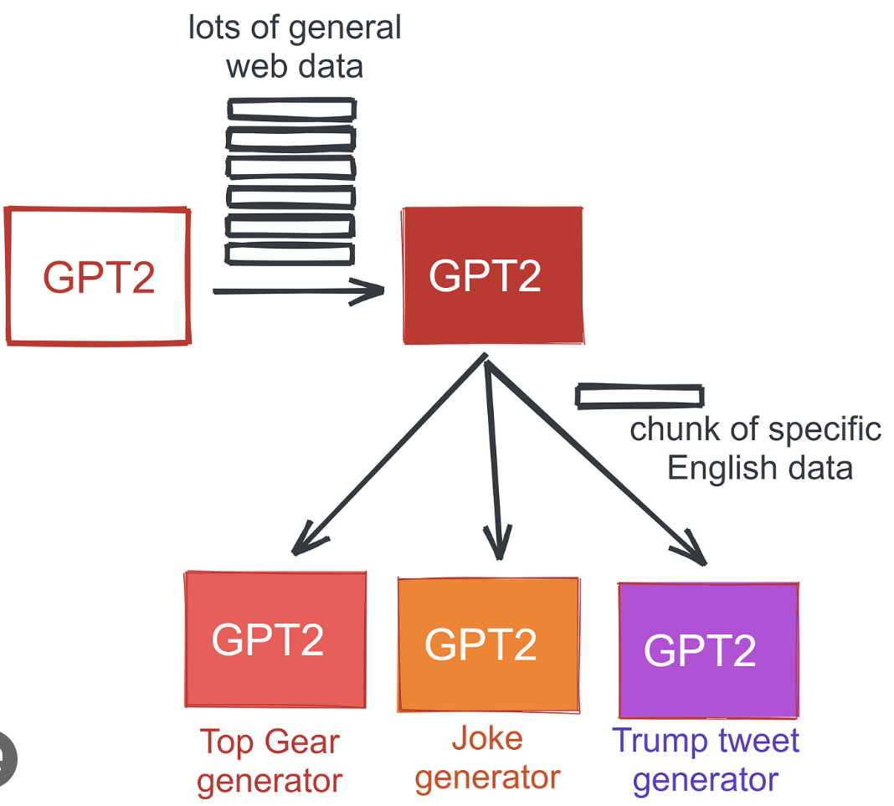
Fine-Tuning
Fine-Tuning Objective: Tailoring GPT-2 to Specialize in Shakespearean English, enhancing its ability to replicate the bard's unique style and vocabulary.
Iterative Training Approach: Employing an iterative training process to continuously refine the chatbot's accuracy and authenticity in emulating Shakespeare's style.
Performance Metrics: Monitoring key performance indicators to ensure the fine-tuned model maintains high standards of linguistic quality and coherence.

Slide 6
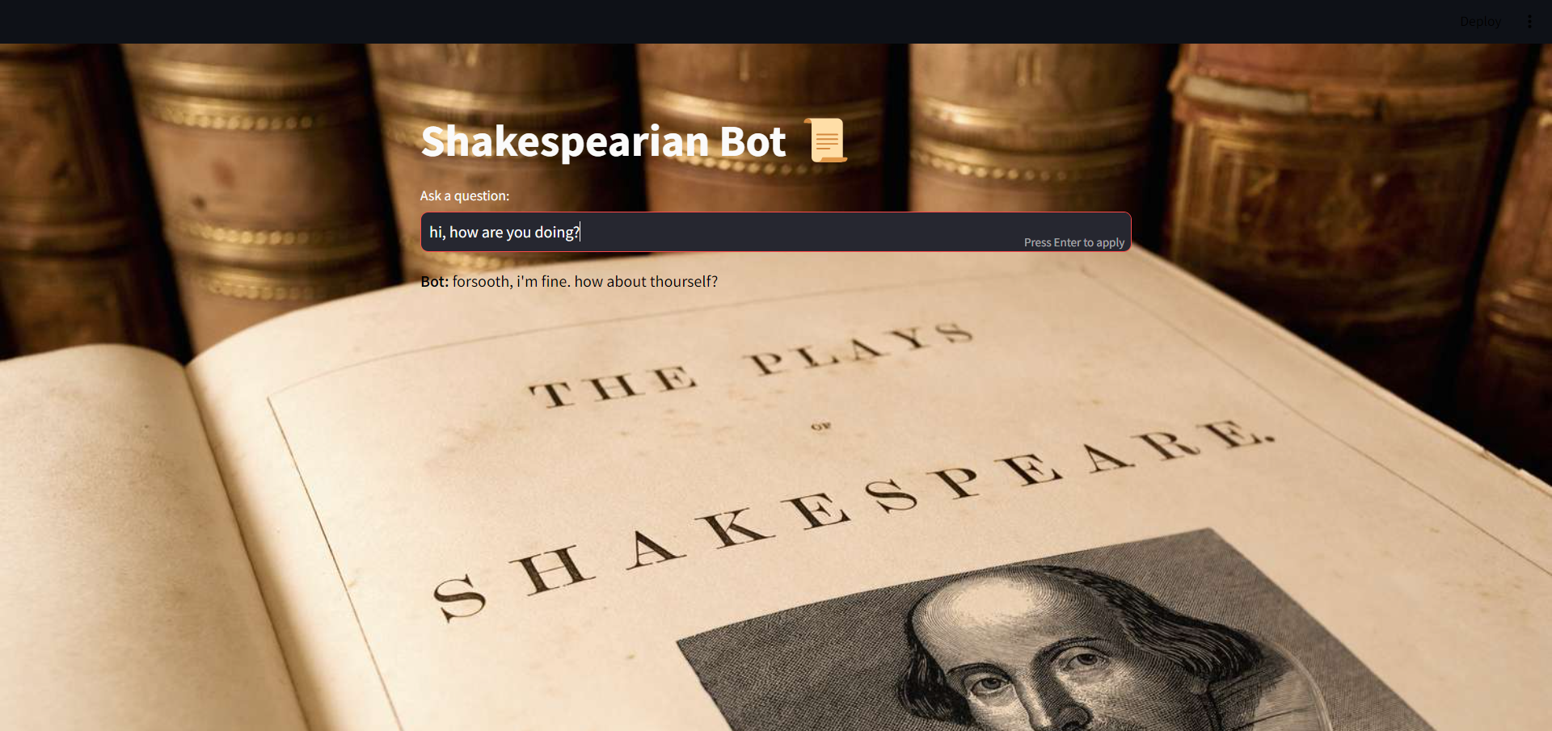
Example:

Slide 7

Example:

Slide 8
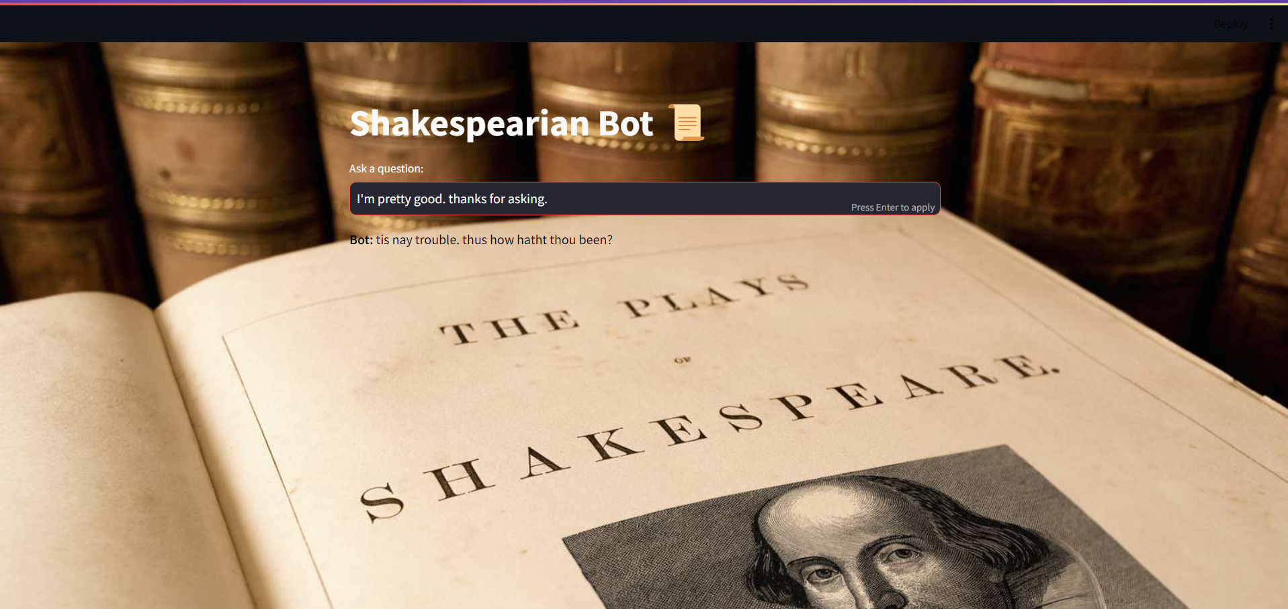
Example:

Slide 9
GIT-HUB: https://github.com/SARMAD-ALI-cyber/SHAKESPEAR-CHATBOT
YOUTUBE: Link

Slide 10
THE END
Any question?

